Slide 1
͢
Level sets of L(β)
v
-∇L(β)
-∇L(β)
β₂
-∇L(β)c
β₁

Slide 2
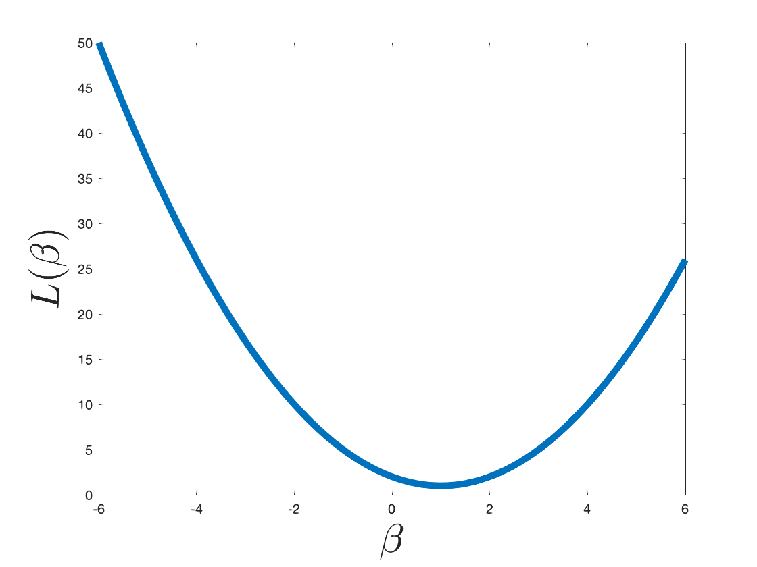
L(β₂)
L(β₁)
β₁
β₂

Slide 3
d features
1
1
...
n examples
...
age
BMI
sex
1
X

Slide 4
y
x

Slide 5
x
✓
✓

Slide 6
This is a sentence.
1
1
1
1
a
aardvark
zyzzyva
zoo

Slide 7
This is a sentence.
1
1
1
“a sentence”
“is a”
“this is”

Slide 8
This is a sentence.
1
1
“is a sentence”
“this is a”

Slide 9
feature extraction
ML
prediction
1
0
1
1
1
0
0
0
0
0
0
1
1
1
0
0 (safe)
1
0
0
0
1
0
1
0
0
1
0
0
0
0
0
1 (spam)
1
0
0
0
0
1
1
1
0
0
0
0
0
0
0
0 (safe)
1
0
0
0
0
1
0
0
1
0
1
0
0
0
0
0 (safe)
1
0
0
0
1
0
1
0
1
0
0
1
1
0
0
1 (spam)

Slide 10
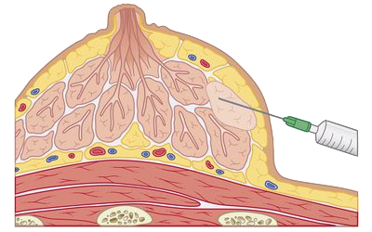
breast lump
syringe/needle
cross section

Slide 11
class 1
class 2
class 3
q classifiers to learn

Slide 12
class 1
class 2
class 3
O(q²) classifiers to learn.

Slide 15
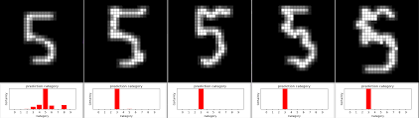

Slide 16
matrix matx
vecx = matx.ravel()
vector vecx
28
1
784
matx = vecx.reshape((28,28))
28
⟶
⟶
x
⟶
x
w
θ
θ
⟶
w

Slide 17
⟶
x
⟶
w

